Slide 1
A Study Of The Book Of Revelation
January 24, 2021

Slide 2

Revelation 12:7-8
Revelation 12
“And there was war in heaven: Michael and his angels (going forth) to war with the dragon; and the dragon warred and his angels; And they prevailed not, neither was their place found any more in heaven.”

Slide 3
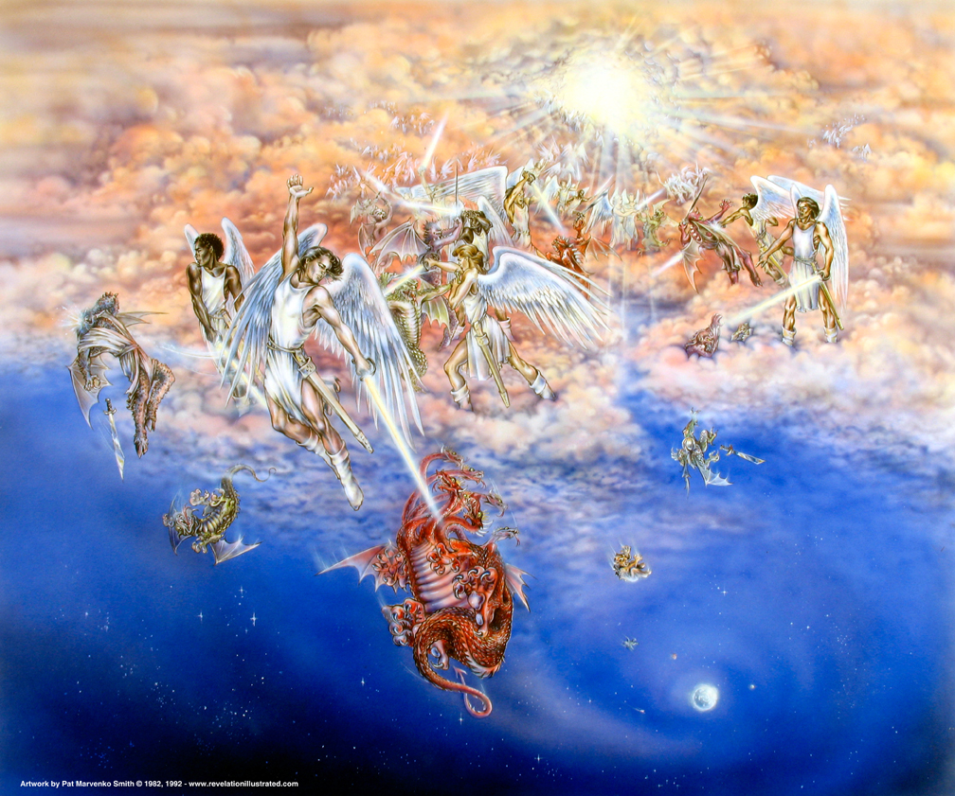
Revelation 12

Slide 4
War in Heaven
Revelation 12
The apocalyptic scene shifts from earth to heaven.
The opponents:
Michael and his angels (Daniel 10:13, 21; 12:1; Jude 9)
versus
Dragon and his angels
Not his first defeat (2 Peter 2:4; Jude 6; Luke 8:31)
Doesn’t stop him from accusing (Job 1)

Slide 5
War in Heaven
Revelation 12
The apocalyptic scene shifts from earth to heaven.
The opponent: (devil)
Power begins to diminish with the ministry of Christ. (Luke 10:18; John 14:30)
It is further limited by the coming of the Holy Spirit. (John 16:8-11)
Christ removed Satan’s power over death. (Hebrews 2:14; John 12:31; 1 John 3:8)
We now have an advocate with the Father. (1 John 2:1-2; James 4:7-8)

Slide 6
War in Heaven
Revelation 12
Symbolic representation of Satan’s angry reaction to the Messiah’s escape from his wicked plot to destroy Him!
Michael and his fellow angels engage them in battle!
Michael and his angels will prevail because they have God’s power and authority behind them!

Slide 7
War in Heaven
Revelation 12
Spiritual warfare behind the scenes.
Satan’s angels were “not strong enough.”
No longer is a place “found for them in heaven”
Resounding defeat in the heavenly realm by Michael and his angels
Complete defeat for Satan, and complete victory for Christ
Satan no longer has any ground to accuse God’s people; it’s all been taken away! (Hebrews 2:14-15)

Slide 8
Revelation 12:9
Revelation 12
“And the great dragon was cast down, the old serpent, he that is called the Devil and Satan, the deceiver of the whole world; he was cast down to the earth, and his angels were cast down with him.”

Slide 9
The Dragon’s Identity Confirmed
Revelation 12
Story of the Garden of Eden “that old serpent” (Genesis 3)
Called the “devil,” “Satan”
Slanderer
Adversary
Constantly opposes mankind
Great force against God
Against His creation
Against His Son
Deception of the entire world (John 8:44)

Slide 10
The Dragon’s Identity Confirmed
Revelation 12
Verse 9 Now the scene shifts back to earth – “cast out into the earth”
“Angels cast out with him”
The devil’s adversarial role continues.
Yet, because of Christ’s death he cannot win!
John’s vision depicts the climax of war between the forces of righteousness and of evil.
This is NOT a discussion of Satan’s origin!

Slide 11
Revelation 12:10
Revelation 12
“And I heard a great voice in heaven, saying, Now is come the salvation, and the power, and the kingdom of our God, and the authority of his Christ: for the accuser of our brethren is cast down, who accuseth them before our God day and night.”
Climax
Matthew 28:18; Daniel 2:44; 7:25;
Hebrews 2:14ff;
Luke 11:21-22; Isaiah 53:12

Slide 12
Revelation 12:10
Revelation 12
“Now is come the salvation, and the power, and the kingdom of our God, and the authority of his Christ”
cf. “But the saints of the Most High shall receive the kingdom, and possess the kingdom for ever, even for ever and ever.” (Daniel 7:18; cf. Daniel 7:22-27).

Slide 13
The Response
Revelation 12
12:10 – Praise given to God for:
The coming of salvation (manifested)
Power (vindicated)
As promised in Daniel 2, in spite of four mighty kingdoms of the earth; God’s Kingdom, God’s purpose would be achieved.
All nations would flow into it. Isaiah 2:2; Micah 4
These would be His subjects. cf. Psalms 2; 110; Revelation 12:5
Christ’s authority (revealed)
Accomplished by His death, burial, and resurrection
Ephesians 1:7
Colossians 1:13-14; 2:15
Matthew 28:18; 1 Peter 3:22

Slide 14
The Response
Revelation 12
12:10 – God receives praise because:
The accuser of the brethren has been cast down.
The devil lost the battle in his great warfare against God.
He was unable to destroy the man child born on earth.
Finally, at Christ’s death, Satan lost the spiritual battle in heaven!
He was unable to prevent the resurrection. (Romans 1:4)
Powerless in any confrontation with God. (Romans 8:33-39)

Slide 15
Revelation 12:11
Revelation 12
“And they overcame him because of the blood of the Lamb, and because of the word of their testimony; and they loved not their life even unto death.”

Slide 16
Formula for Victory
Revelation 12
WHO conquered and gained the victory and HOW did they do it?
The brethren, who suffered at the hands of Satan OVERCAME!
But HOW?

Slide 17
Formula for Victory
Revelation 12
12:11 – Three answers are given as to HOW:
1. By the blood of the Lamb. God, through His grace, provided the means of forgiveness by sacrificing Christ! Thus, He purified our souls!
1 Peter 1:18-20; Ephesians 2:8-9, 10-11; 1 Peter 1:22-23; Romans 6:3-4; Revelation 1:5-6.
2. And by the word of their testimony. More than confessing their sins (1 John 1:9) – unashamed confession of their faith shown in their faithful lives. Unwilling to bow to Caesar as God! Committed Christians are known by the lives they live!
Matthew 10:32-33; Romans 10:9-10; Galatians 6:7-8.

Slide 18
Formula for Victory
Revelation 12
12:11 – Three answers are given as to HOW:
By the blood of the Lamb.
And by the word of their testimony.
And they loved not their lives unto the death. Total commitment and love for God was seen in their willingness to die for their faith! No worldly compromise. Understood that God – not men – are to be feared! Obeyed the gospel and lived it!
Matthew 10:28; 16:26

Slide 19
Revelation 12:12
Revelation 12
“Therefore rejoice, O heavens, and ye that dwell in them. Woe for the earth and for the sea: because the devil is gone down unto you, having great wrath, knowing that he hath but a short time.”

Slide 20
Cause to Rejoice!
Revelation 12
All who belong to God can rejoice!
The heavenly angels and all the loyal saints who emerged from the great tribulation celebrate because of Satan’s defeat!
“Woe to the earth” he has lost in heaven, and only the earth is left!
Has only a “short time” to persecute God’s people!
cf. Revelation 6:9-11
He Knows his time is limited, so turns his evil arsenal on the church – God’s children!

Slide 21
Revelation 12:13
Revelation 12
“And when the dragon saw that he was cast down to the earth, he persecuted the woman that brought forth the man (child).”

Slide 22
The Woman Persecuted
Revelation 12
Satan knows he must fight on earth.
This antagonism originated with Satan’s hatred for Christ!
He turns his attention to the children of his conqueror!
Primary application to Revelation is the Roman persecution, the beast’s great persecution of the church.
Yet, to this day Satan persecutes God’s children by encouraging them to abandon their faith!

Slide 23
Revelation 12:14
Revelation 12
“And there were given to the woman the two wings of the great eagle, that she might fly into the wilderness unto her place, where she is nourished for a time, and times, and half a time, from the face of the serpent.”
Revelation 11:3; 12:6, 14; 13:5; cf. Daniel 7:25

Slide 24
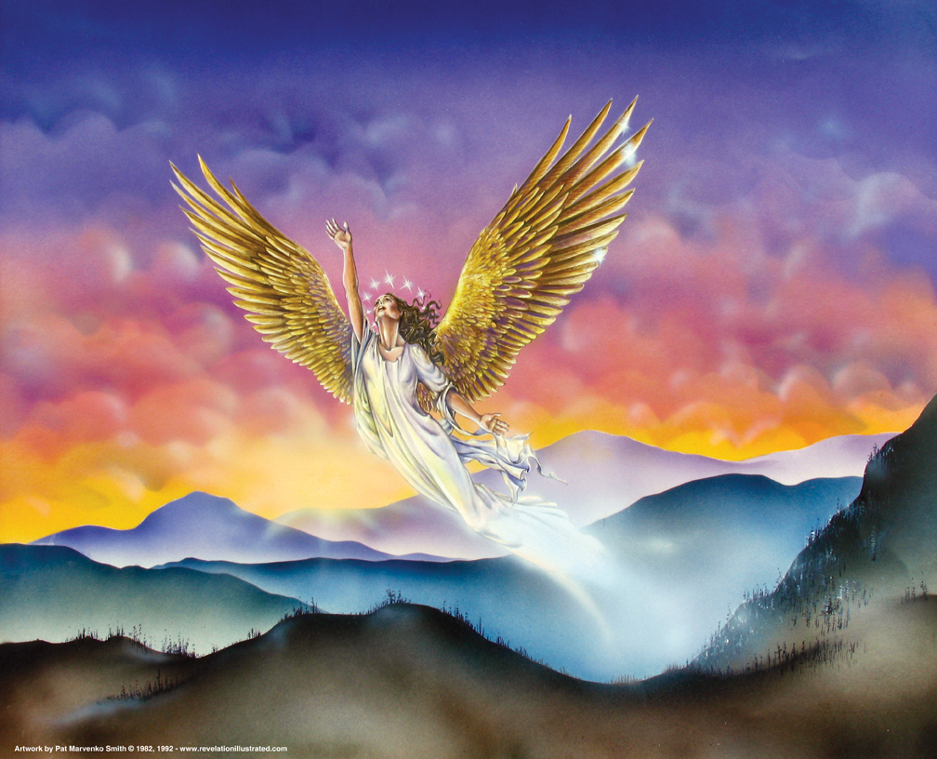
Revelation 12

Slide 25
Flight of the Woman
Revelation 12
Where she is nourished for a time, and times, and half a time, from the face of the serpent. Three and a half years is equivalent to 1,260 days (verse 6) and forty-two months occurring elsewhere in the book.
The two witnesses shall prophesy 1,260 days (11:3).
The holy city shall be trodden under foot forty-two months (11:2; 13:5).
The woman is nourished for a time, times, and half a time (12:6, 14).
The fourth kingdom would war against the saints for a “time, times, and the dividing of time” (Daniel 7:25). The fulfillment of Daniel’s prophecy is revealed to John. The recipients are under severe persecution from the Roman Empire.
The promise being assured throughout Revelation is that God will nourish His people through the time of testing.

